Slide 1
Shell Bootcamp 2024
SAP-ERP FUNCTIONAL 3 Reflections for Week 5 (23-Sep-2024 – 27-Sep-2024)
Hitesh
Date : 27-Sep-2024

Slide 2

About Me
Honesty is the first chapter in the book of wisdom.

Slide 3

My learnings from this week!

Slide 4
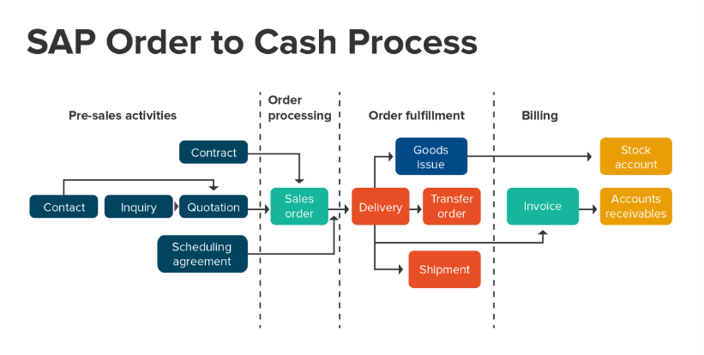
Learning 1 | My takeaways
Key Learning: Order to Cash Flow and Pricing Procedure
Key Takeaway: OTC involves managing the entire process from sales order to customer payment, with pricing procedures ensuring accurate product pricing.
How I See It Implemented in the Energy Sector: Energy companies use OTC to manage customer contracts and pricing, adjusting for market variables and ensuring compliance.
Key Learning: Plant, Sales Org., Distribution Channels, Delivery, Goods Issued, Invoice
Key Takeaway: Configuring plants, sales organizations, and channels ensures smooth operations, while deliveries, goods issued, and invoices track product flow and revenue.
How I See It Implemented in the Energy Sector: Energy firms use these configurations to manage distribution and logistics, ensuring seamless operations from production to customer delivery.

Slide 5
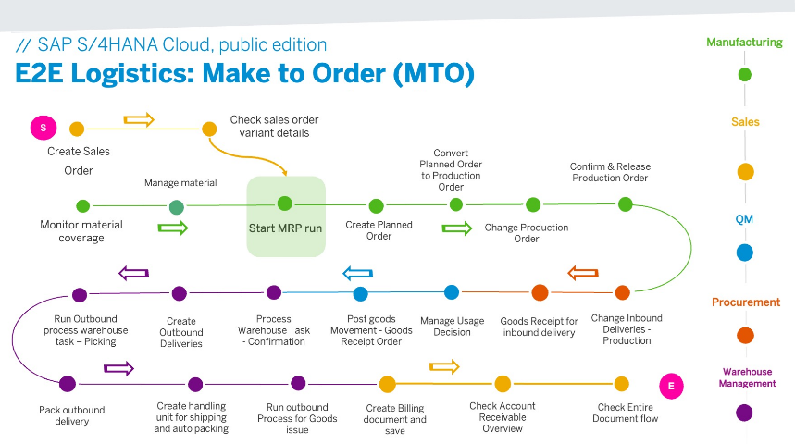
Learning 2 | My takeaways
Key Learning: Make to Order Flow (PR - RFQ - Quotation - PO - GR - IR)
Key Takeaway: The make-to-order process begins with a purchase requisition (PR) and follows a chain from requests for quotations (RFQs) to purchase orders (POs), goods receipts (GRs), and invoice receipts (IRs).
How I See It Implemented in the Energy Sector: This process is vital for custom orders in the energy industry, such as when a customer needs a specific type of transformer or a custom-built rig. Efficient make-to-order processes enable energy companies to meet customer specifications while managing procurement and production timelines.

Slide 6
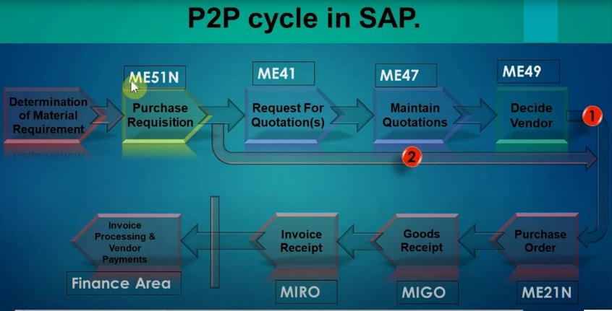
Learning 3 | My takeaways
Optimizing Procurement with Procure to Pay
Key Learning: Procure to Pay Flow, Ariba, Supply Chain Management (SCM)
Key Takeaway: The procure to pay (P2P) process covers the entire procurement lifecycle from sourcing to payment, often integrated with Ariba for supplier collaboration and enhanced SCM for inventory management.
How I See It Implemented in the Energy Sector: Energy companies use the P2P process to handle large-scale procurement needs, such as securing raw materials (e.g., oil, gas, equipment) while optimizing inventory through SCM systems. Ariba allows for better supplier management, reducing procurement lead times and improving cost-efficiency in high-stakes projects.

Slide 7

Relevance of learnings for my organization

Slide 8
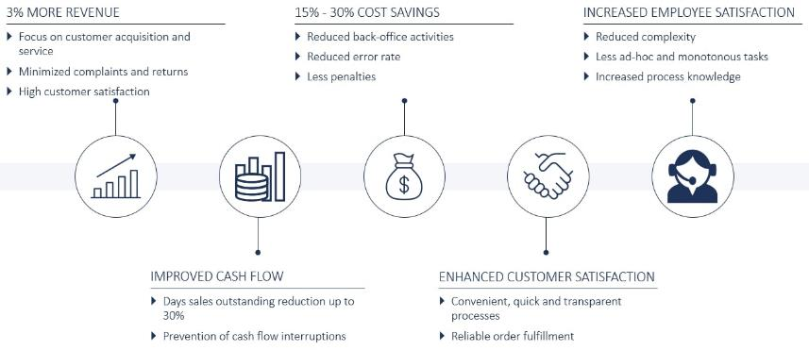
Learning 1 | Relevance for Shell
Streamlining Order to Cash in SAP
How I Feel Shell Implements This Learning:
Shell likely uses the OTC flow to manage sales of oil, gas, and related products, integrating pricing procedures to reflect dynamic market rates and contracts.
How I Feel Shell Benefits From This Learning:
By using efficient OTC and pricing processes, Shell ensures timely payments, accurate invoicing, and flexible pricing, ultimately improving revenue management and customer satisfaction.

Slide 9
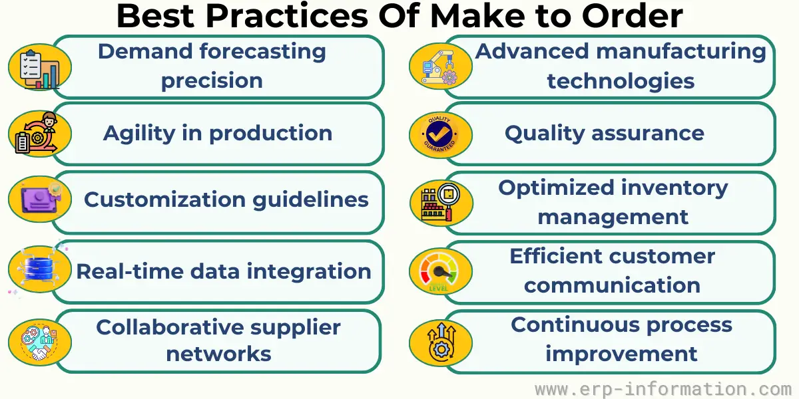
Learning 2 | Relevance for Shell
Make to Order Process in SAP
How I Feel Shell Implements This Learning:
Shell might use the make-to-order process to fulfill specialized equipment orders, such as custom rigs or refinery components, adhering to precise customer specifications.
How I Feel Shell Benefits From This Learning:
This approach helps Shell streamline procurement for custom projects, reduce production delays, and meet customer demands efficiently, enhancing project timelines and profitability.

Slide 10
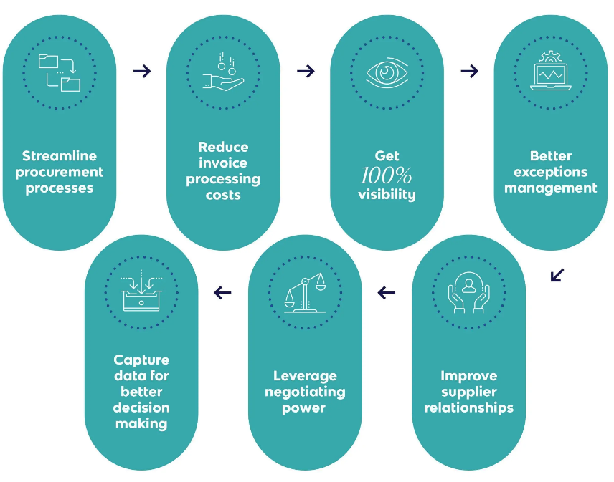
Learning 3 | Relevance for Shell
Optimizing Procurement with Procure to Pay
How I Feel Shell Implements This Learning:
Shell likely leverages the procure-to-pay flow to source essential raw materials and manage supplier relationships through Ariba, while optimizing inventory with SCM tools.
How I Feel Shell Benefits From This Learning:
Shell benefits by reducing procurement lead times, improving supplier collaboration, and maintaining optimal inventory levels, which enhances cost control and supply chain efficiency across global operations.

Slide 11

Challenges in implementing learning

Slide 12

Challenge faced while implementing Learning 1
Streamlining Order to Cash in SAP
Challenge Faced:
Integrating accurate pricing procedures into the OTC flow can be difficult due to constantly fluctuating market rates and complex contractual terms in the energy sector.
Plan to Overcome:
Implement dynamic pricing models within SAP and ensure regular updates through market analysis to maintain accuracy and compliance.

Slide 13

Challenge faced while implementing Learning 2
Make to Order Process in SAP
Challenge Faced:
Coordinating procurement and production for custom orders can lead to delays, especially when multiple vendors or specialized materials are required.
Plan to Overcome:
Improve vendor communication using SAP tools like RFQs and POs and streamline order tracking to ensure all parts and materials arrive on schedule.

Slide 14

Challenge faced while implementing Learning 3
Optimizing Procurement with Procure to Pay
Challenge Faced:
Managing supplier relationships through Ariba and optimizing inventory using SCM can be complex due to the scale of operations and global supplier base.
Plan to Overcome:
Enhance supplier collaboration through Ariba’s advanced features and implement real-time inventory monitoring in SAP to better predict procurement needs and avoid stockouts or overstocking.

Slide 15

Action Plan

Slide 16
My Action Plan for this Week
Actions
Timeline
Status
Review dynamic pricing models in SAP for better integration into the Order to Cash flow.
Enhance communication with vendors by setting up automated RFQs and tracking systems in SAP for custom orders.
Explore and implement advanced features of Ariba for improved supplier collaboration.
Set up real-time inventory monitoring in SAP for better stock management within the Procure to Pay flow.
2 Days
3 Days
2 Days
3 Days
Pending
In Progress
Pending
In Progress

Slide 17

Learning is also Fun!

Slide 18
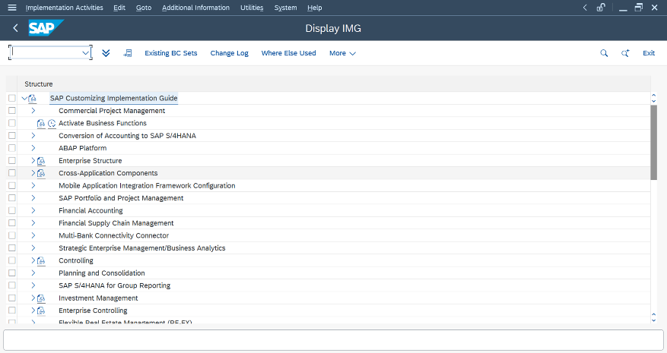
Learning is also Fun!
Activity:
We had interactive jam sessions and engaging story sessions where team members shared insights about their specialties. These sessions gave me a deeper understanding of my colleagues' expertise while building a collaborative learning environment.
A big relief came when we transitioned to hands-on practical sessions after several long days of theory. The practical work allowed us to apply what we had learned, making the experience more dynamic and engaging.

Slide 19

Summary
Quick Summary:
This week’s focus was on three key SAP processes: Order to Cash, Make to Order, and Procure to Pay. Each topic provided insights into managing critical business functions such as pricing, production, procurement, and supplier collaboration, essential for streamlining operations in the energy sector.
Importance of Topics for Upcoming Week:
The learnings will be essential next week as I dive deeper into optimizing SAP workflows. Dynamic pricing models, vendor management, and inventory control will be crucial areas to explore further to ensure seamless integration and efficiency improvements across processes.
Connectivity of Topics from Current Week:
The topics covered this week are interconnected, as all three (OTC, Make to Order, and Procure to Pay) contribute to a complete cycle of sales, production, and procurement. Mastering these processes allows for better resource allocation, financial management, and timely delivery, aligning with Shell’s operational needs.

Slide 20
Thank You

